Slide 1

KALERWE
S.D.A Hymnal 455 (tune)
4 ~ Verses
60.
“Mugende Munsi Zonna”.…
~
For My Sake and the Gospel Go…

Slide 2

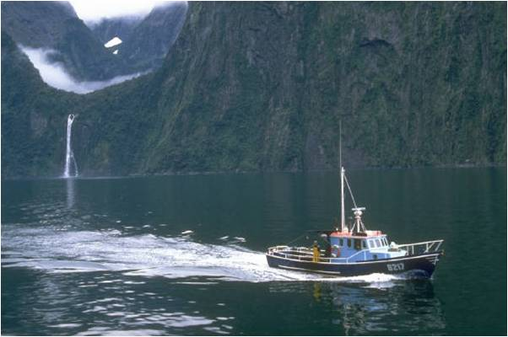
1 of 4 verses
“Mugende munsi zonna
Mubuulir(e) Enjiri”-
Er(i) amawanga gonna
Agabeera mu nsi,
Balyoke bategere
Yesu Gwe tu-sinza-
Bw’ali Katonda ddala,
Bw’alokola bonna.

Slide 3
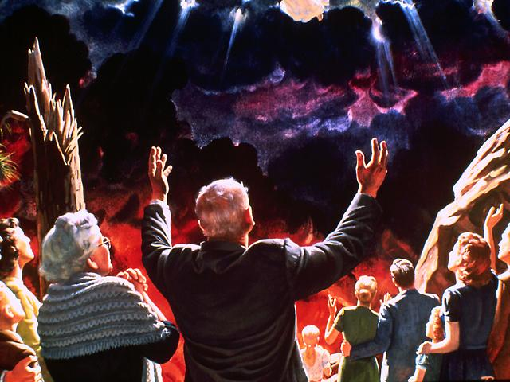
2 of 4 verses
Mukama waffe Yesu,
(O)tunyikize ffena,-
Tukolerenga ddala
ebitusaanira;
Tweweyo gy’oli leero,
(E)mibiri n’e-myoyo,
Tuleteng(a) ebirabo
N’essanyu lingi nnyo.

Slide 4
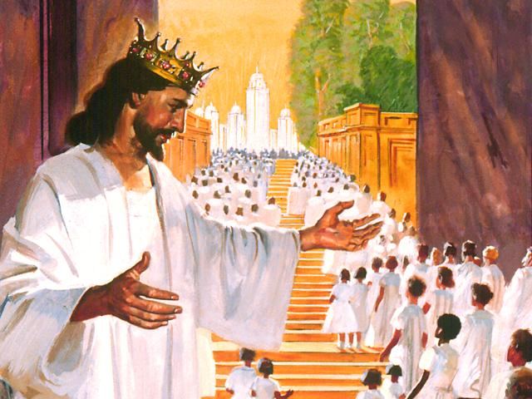
3 of 4 verses
“(O)kugaba kwa mukisa
(O)kusinga (o)kuweebwa”-
Byonna byetuli nabyo
Biv(a) eri Katonda;
(O)tukirizise ebyo,
Tukwegayi-ridde-
Tulem(e) okugamba nti
Bye byaffe ku bwaffe.

Slide 5
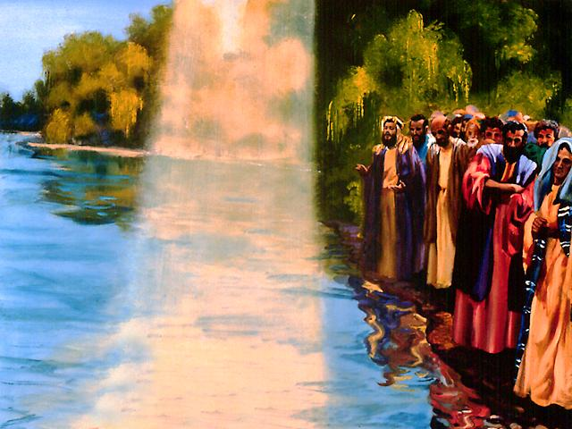
4 of 4 verses
Ayi Katonda Kitaffe,
Oyimuse muffe-
(A)bakunguzi abangi,
Balyoke bagende
Banyikire nga wonna
(O)kubuny(a) enji-ri yo,-
Babulirenga bonna.
(A)bakulu n’abato.

